Slide 1

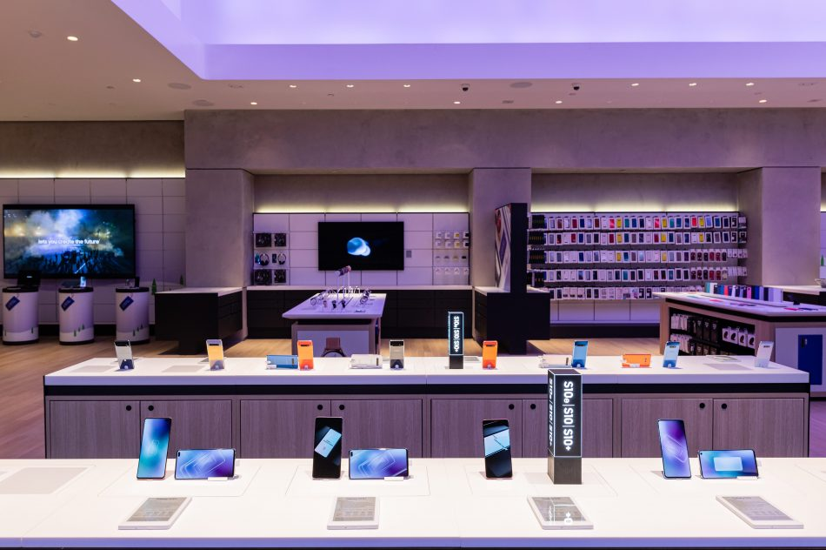

Feature Extraction and Price Prediction-Cell Phones
Title- Price Prediction with ML Models
Name-Debasis Panda
GitHub- https://github.com/Deb052024/Machine-Prediction.git

Slide 2
Feature Extraction and Model Building-Case Flow
Overview of Project and Data Exploration
EDA Based Features Observation - 1 ,2
Highest Market Price Models Features Plot
Feature Importance and Selection
Supervised Machine Learning Model Building and Performance Based on KPI
Cross Validations
Recommendation and Conclusion

Slide 3
Overview of Project and Data Exploration
Project Scenario:
The organization is keen to enhance its pricing strategy by gaining a deeper understanding of the key features that influence the prices of mobile phones.
Objective: is to build a predictive model that can accurately estimate the price of a mobile phone based on its features.
Primary Goal:
The goal of the project is to develop a predictive model for mobile phone prices.

Slide 4
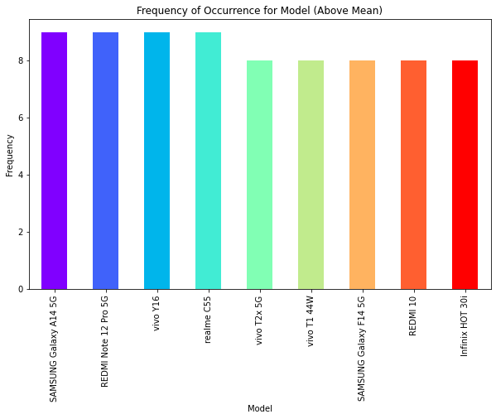
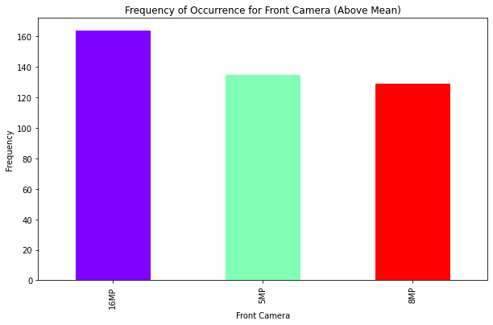
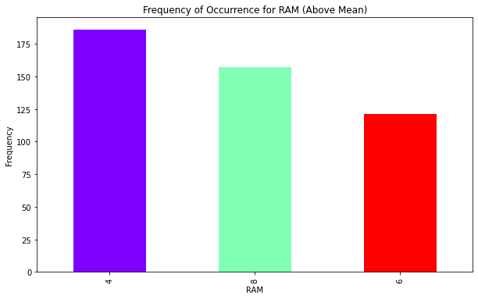
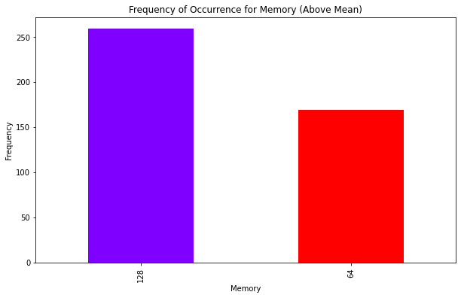
EDA Based Observations Across Models-1
Interpretation:
SAMSUNG Galaxy A145G, REDMI Note 12Pro 5G, VIVO Y16, realmeC55 have got maximum occurrences
Features- Maximum cell phones with 126GB Memory, 4 GB RAM and 16MP Front camera

Slide 5
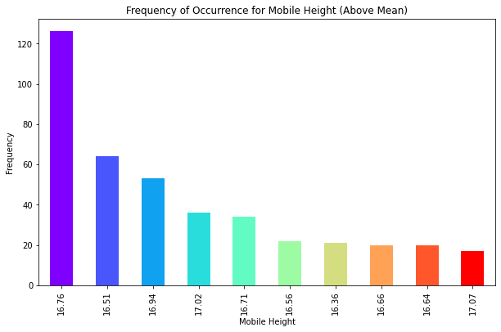
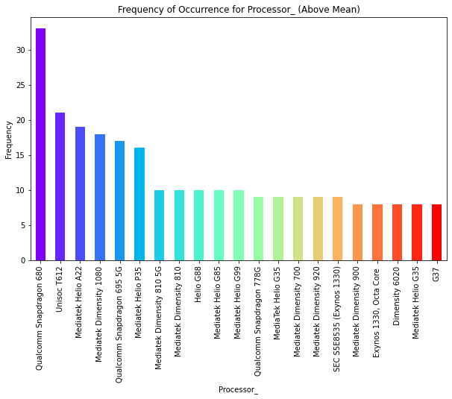
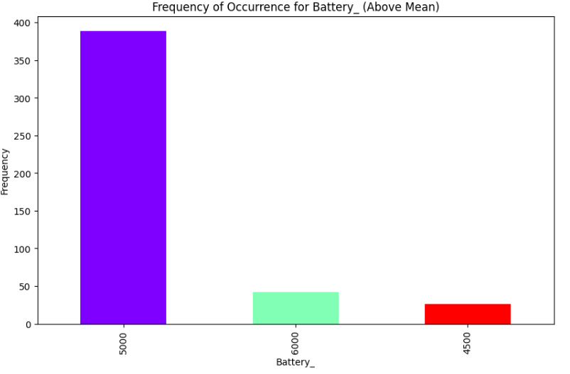
EDA Based Observations Across Models-2
Interpretation
16.76 inch height handset are having maximum presence in the distribution
Qual Comm Snap Dragon Processors are mostly used in cell Phones
5000mH battery is mostly present across cell phones

Slide 6
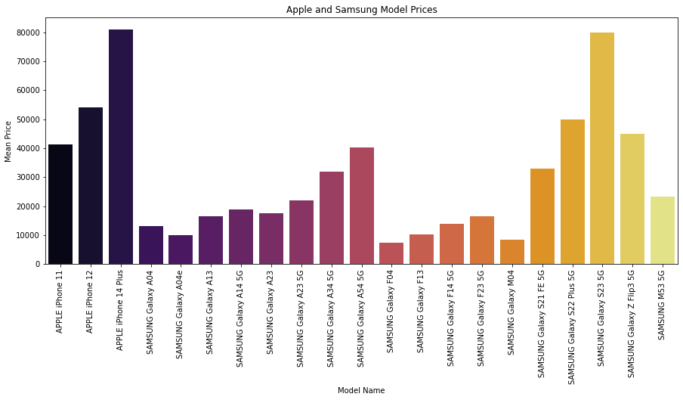
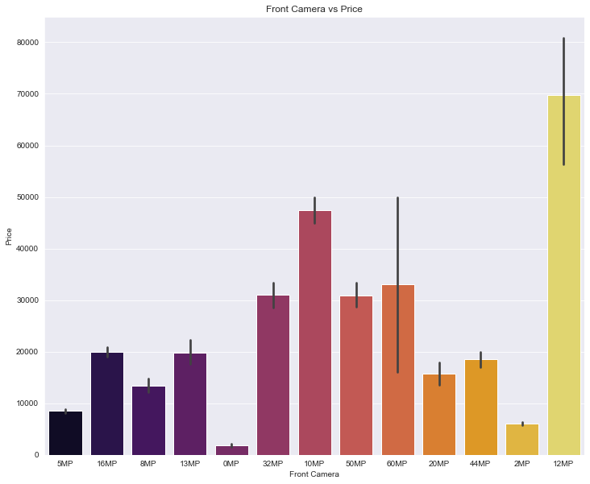
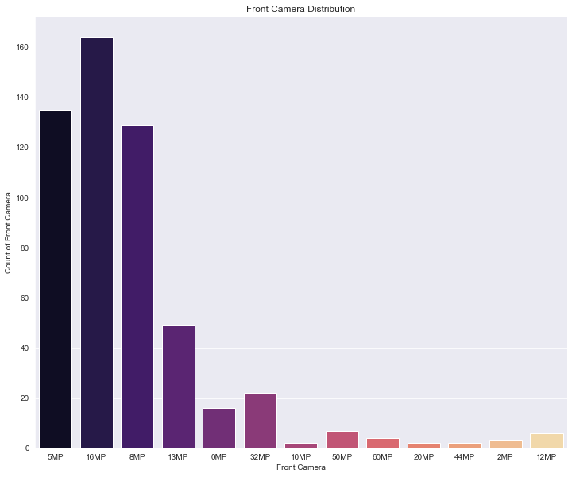
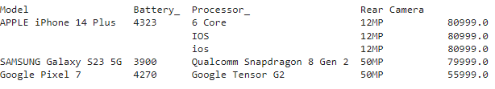
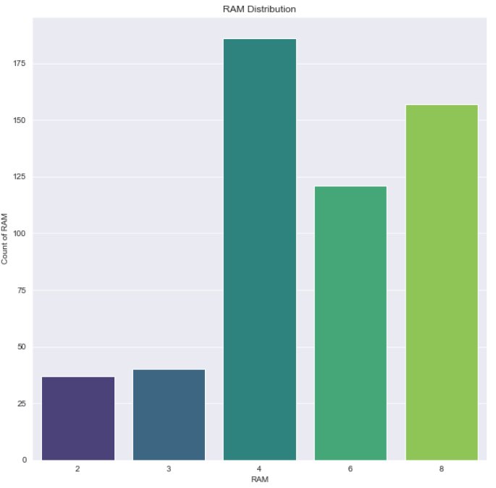
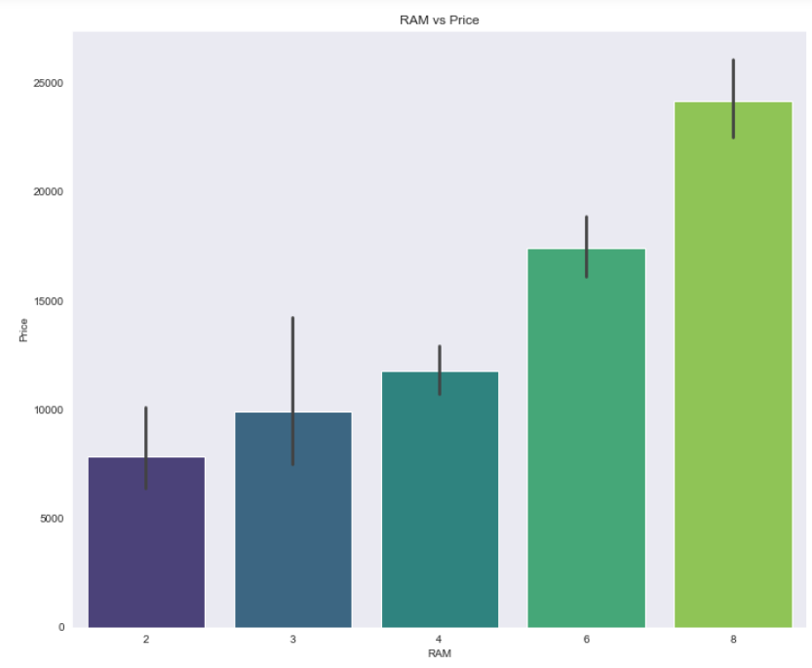
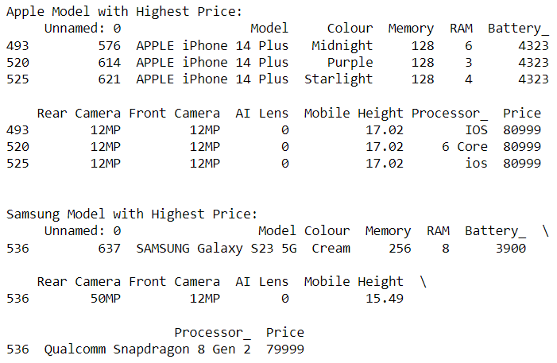
Highest Market Price Model -Features
Top three brands with highest selling prices are Apple iPhone 14 Plus, Samsung Galaxy S23 5G and Google Pixel 7
Apple Phones are most costliest in market with equal front and Rear camera of 12 Mega Pixel
With 128GB Memory APPLE are the costliest with bigger heights compared to 256GB Memory of Samsung Cell Phones, Brand being the differentiator
12MegaPixel Front camera are costliest for Apple and Samsung but most cameras present are of 10 or 8 Mega Pixel,
8GM RAM is the most sought after for Samsung - how ever the current distribution is having most cell phones with 4GB RAM

Slide 7
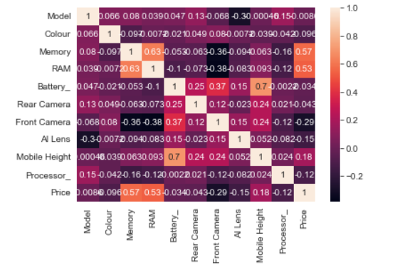
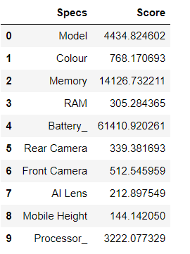
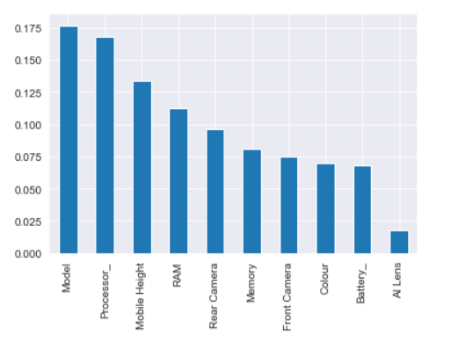
Feature Importance and Selection
Heat Map Method –Finding Correlation among Features
Based on High Degree of positive correlation – Key Features related to price are –Memory, RAM, Mobile Height
Based on SelectKBest Method –Key Features are – Model, Battery, Memory, Processor
Based on ExtraTree Classifier Method –Key Features are – Model, Battery, Mobile Height ,Processor

Slide 8
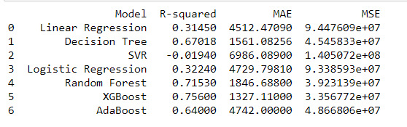
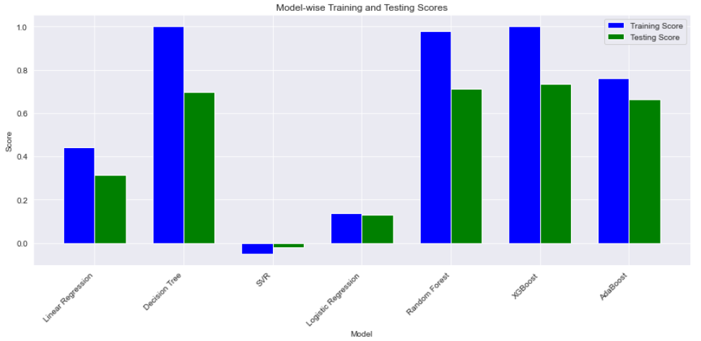
Supervised Regression Machine Learning Models and KPI
 | Scores
Model Name | Training Accuracy | Testing Accuracy
Linear Regression | 0.44 | 0.31
Decision Tree Regressor | 0.99 | 0.69
Support Vector Regressor | -0.05 | -0.019
Logistics Regression | 0.13 | 0.12
Random Forest Regressor | 0.97 | 0.71
XGB Regressor | 0.99 | 0.74
AdaBoost Regressor | 0.76 | 0.66
Logistics Regression Training and Testing score are least
XGBoost and Random Forest Regressor scores are highest and scond highest
R^2 , Mean Absolute Error and Mean Square values indicate XGBoost is the best predictor model for Price, but its bit over fit
The difference between train and test accuracy score is least for AdaBoost , hence is a best fit model, neither over fit or under fit
Adjacent graph depicts ensemble techniques perform well compared to individual learner models

Slide 9
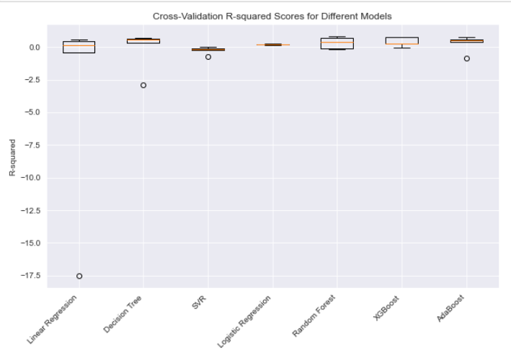
Cross Validation Comparison
Based on Cross Validation R*2 scores across models were plotted
SVR R*2 scores are lowest with outliers
More spread on validations on higher side for XGBoost and Random Forest,AdaBoost

Slide 10
Recommendations and Conclusion
Top three brands with highest selling prices are Apple iPhone 14 Plus, Samsung Galaxy S23 5G and Google Pixel 7
With 128GB Memory APPLE are the costliest with bigger heights compared to 256GB Memory of Samsung Cell Phones, Brand being the differentiator
12MegaPixel Front camera are costliest for Apple and Samsung but most cameras present are of 10 or 8 Mega Pixel,
8GM RAM is the most sought after for Samsung - how ever the current distribution is having most cell phones with 4GB RAM
Ensemble Techniques perform better in Model Accuracy than normal learning models
XGBoost is having highest accuracy but bit overfit how ever AdaBoost is neither overfit nor under fit in price predictions
R*2 square with least MAE(Mean Absolute Error ) is present for XGBoost

